Slide 1
University of Basrah
Al-Zahraa Medical College
Ministry of higher Education and Scientific Research
Academic year 2021-2022
5th year
REPRODUCTIVE BLOCK
Lecture
Duration : 1 hour
OBSTETRICS HISTORY AND EXAMINATION
Presented by
Dr.RAYA MUSLIM AL HASSAN
Block staff:
Dr.Raya Muslim Al Hassan (module leader)
Dr.Marwa Sadik (coleader)
Dr. Abdul kareem Hussain Subber
Dr.Alaa Hufdhi
GYNAECOLOGY 20th
EDITION by Ten Teachers

Slide 2
LEARNING OBJECTIVES
University of Basrah
Al-Zahraa Medical College
Ministry of higher Education and Scientific Research
To understand the principles of taking an obstetric history.
To understand the key components of an obstetric examination.
How to perform an appropriate obstetric examination.

Slide 3
University of Basrah
Al-Zahraa Medical College
Ministry of higher Education and Scientific Research
You are the resident doctor in the labour ward and you want to take a history from a_22_year old pt who is complaining from vaginal bleeding and mild abdominal pain

Slide 4
University of Basrah
Al-Zahraa Medical College
Ministry of higher Education and Scientific Research
introduce yourself; tell the patient who you are and why you have come to see them.
Make sure that the patient is seated comfortably.
Take a permission.
Make sure you are wearing your identity badge.
Wash your hands or use alcohol gel.
Be gentle.
Always have a chaperone present when you examine patient

Slide 5
University of Basrah
Al-Zahraa Medical College
Ministry of higher Education and Scientific Research
The main parts of history are:
Identity
Chief complaint
History of present illness
Review of systems
Obstetric history
Gynaecological history
Social history
Drug history
Medical and Surgical history
Family history

Slide 6
IDENTITY
University of Basrah
Al-Zahraa Medical College
Ministry of higher Education and Scientific Research
Name
Age
Occupation
Marital status
Blood group
LMP/EDD
Adress
gravidity (G)
Parity(P)
Her husband name ,age ,occupation and blood group
Next of kin.

Slide 7
University of Basrah
Al-Zahraa Medical College
Ministry of higher Education and Scientific Research
Chief Complaint
History of present illness:
A-analysis of chief complaint
B-patient reaction
C-action to the pt.
D-her condition now
Review of systems
Drug history
Family history
Social history
Medical and surgical history

Slide 8
Gynaecological history
University of Basrah
Al-Zahraa Medical College
Ministry of higher Education and Scientific Research
A/menstrual cycle is regular or not/length/duration/any problems
b/contraception
c/last cervical smear
d/gynaecological operations
e/PID

Slide 9
Obstetric history
University of Basrah
Al-Zahraa Medical College
Ministry of higher Education and Scientific Research
Marriage –conception period
Analysis of each pregnancy:
First trimester:nausea/vomiting/VB/fever/illness
Second trimester:fetal movement/+…..
Third trimester:VB/blood transfusion/D.M/Ht
Delivery
Postpartum:bleeding/fever

Slide 10
Obstetric examination
University of Basrah
Al-Zahraa Medical College
Ministry of higher Education and Scientific Research
Inspection /
Assess the shape of the uterus and note any asymmetry.
Look for fetal movements.
Note any signs of pregnancy such as striae gravidarum (stretch marks) or linea nigra (the faint brown line running from the umbilicus to the symphysis pubis).
Look for scars.
The common areas to find scars are:
suprapubic (caesarean section, laparotomy for ectopic pregnancy or ovarian masses);
sub-umbilical (laparoscopy);
right iliac fossa (appendicectomy);
right upper quadrant (cholycystectomy).

Slide 11
Palpation
The purpose of palpating the pregnant abdomen is to assess:
- The number of babies.
- The size of the baby.
- The lie of the baby.
- The presentation of the baby.
- Whether the baby is engaged.
- Symphysis–fundal height measurement Symphysis–fundal height (SFH) should be measured and recorded
Auscultation

Slide 12
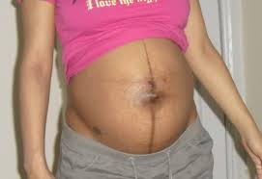

Slide 13
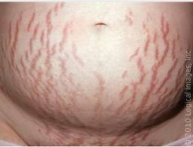

Slide 15
University of Basrah
Al-Zahraa Medical College
Ministry of higher Education and Scientific Research
LARGE FOR DATE
1. wrong date.
2. twin.
3. macrosomic baby.
4. polyhydramnios.
5. fibroid.
6. full bladder.
7.maternal obesity.

Slide 16
SMALL FOR DATE
University of Basrah
Al-Zahraa Medical College
Ministry of higher Education and Scientific Research
1. wrong date.
2. intrauterine death.
3. IUGR.
4.oligohydramnios.
5.trasverse lie.

Slide 17
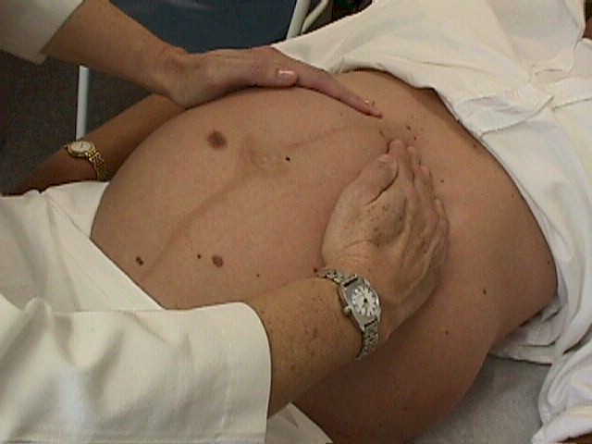
1.Fundal grip it is used to determine which fetal part occupy the upper uterine segment.

Slide 18
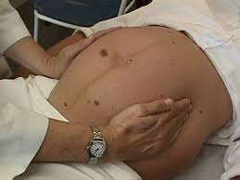
. lateral grip it is used to determine the lie of the fetus,and the location of the back
University of Basrah
Al-Zahraa Medical College
Ministry of higher Education and Scientific Research

Slide 19
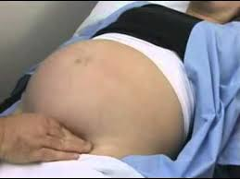
First pelvic grip (PawlicK grip) IT IS used to determine if the presenting part is engaged or not.
University of Basrah
Al-Zahraa Medical College
Ministry of higher Education and Scientific Research

Slide 20
Second pelvic grip: It is used to determine which part occupy the lower uterine segment.and degree of fetal head flexion
University of Basrah
Al-Zahraa Medical College
Ministry of higher Education and Scientific Research

Slide 21
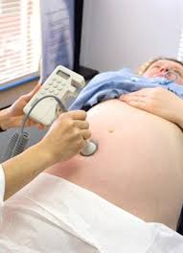
Auscultation sonicaid
University of Basrah
Al-Zahraa Medical College
Ministry of higher Education and Scientific Research

Slide 22
University of Basrah
Al-Zahraa Medical College
Ministry of higher Education and Scientific Research
Normal fetal heart rate is between 110 - 160 BPM,
its location is : -
Below the maternal umbilicus in case of cephalic presentation.
Above the maternal umbilicus in case of breech presentation.
In the maternal flank in case of shoulder presentation.

